Slide 1
DOM Parser

Slide 2
Java DOM Parser
The Document Object Model is an official recommendation of the World Wide Web Consortium (W3C).
It defines an interface that enables programs to access and update the style, structure, and contents of XML documents.
XML parsers that support the DOM implement that interface.

Slide 3
When to use DOM?
You should use a DOM parser when:
You need to know a lot about the structure of a document
You need to move parts of the document around (you might want to sort certain elements, for example)
You need to use the information in the document more than once

Slide 4
DOM Parsing
When you parse an XML document with a DOM parser, you get back a tree structure that contains all of the elements of your document.
The DOM provides a variety of functions you can use to examine the contents and structure of the document.

Slide 5
DOM Interfaces
The DOM defines several Java interfaces. Here are the most common interfaces:
Node - The base datatype of the DOM.
Element - The vast majority of the objects you'll deal with are Elements.
Attr Represents an attribute of an element.
Text The actual content of an Element or Attr.
Document Represents the entire XML document. A Document object is often referred to as a DOM tree.

Slide 6
Common DOM methods
When you are working with the DOM, there are several methods you'll use often:
Document.getDocumentElement() - Returns the root element of the document.
Node.getFirstChild() - Returns the first child of a given Node.
Node.getLastChild() - Returns the last child of a given Node.
Node.getNextSibling() - These methods return the next sibling of a given Node.
Node.getPreviousSibling() - These methods return the previous sibling of a given Node.
Node.getAttribute(attrName) - For a given Node, returns the attribute with the requested name.

Slide 7

Steps to Using DOM
Following are the steps used while parsing a document using DOM Parser.
Import XML-related packages.

Slide 8

Steps to Using DOM
Following are the steps used while parsing a document using DOM Parser.
Create a DocumentBuilder

Slide 9

Steps to Using DOM
Following are the steps used while parsing a document using DOM Parser.
Create a Document from a file or stream

Slide 10
Steps to Using DOM
Following are the steps used while parsing a document using DOM Parser.
Extract the root element

Slide 11

Steps to Using DOM
Following are the steps used while parsing a document using DOM Parser.
Examine attributes

Slide 12

Steps to Using DOM
Following are the steps used while parsing a document using DOM Parser.
Examine sub-elements

Slide 13
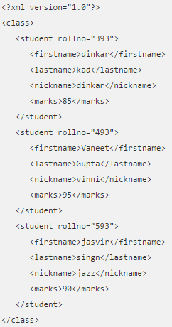
Example Xml
Note: ‘rollno’ is an attribute
Notes:
<?xml version="1.0"?> <class> <student rollno="393"> <firstname>dinkar</firstname> <lastname>kad</lastname> <nickname>dinkar</nickname> <marks>85</marks> </student> <student rollno="493"> <firstname>Vaneet</firstname> <lastname>Gupta</lastname> <nickname>vinni</nickname> <marks>95</marks> </student> <student rollno="593"> <firstname>jasvir</firstname> <lastname>singn</lastname> <nickname>jazz</nickname> <marks>90</marks> </student> </class>

Slide 14
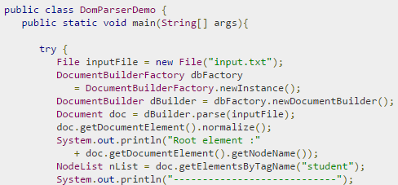
Example Dom Parser (contd.)
Using previous steps:
Create DocumentBuilder
Create a Document
Get root element
Note: get list of all students using:
NodeList nList = doc.getElementsByTagName("student");
1.
2.
3.
Notes:
// ALT+SHIFT+F auto indent in netbeans
import java.io.File; import javax.xml.parsers.DocumentBuilderFactory; import javax.xml.parsers.DocumentBuilder; import org.w3c.dom.Document; import org.w3c.dom.NodeList; import org.w3c.dom.Node; import org.w3c.dom.Element; public class DomParserDemo { public static void main(String[] args){ try { File inputFile = new File("input.txt"); DocumentBuilderFactory dbFactory = DocumentBuilderFactory.newInstance(); DocumentBuilder dBuilder = dbFactory.newDocumentBuilder(); Document doc = dBuilder.parse(inputFile); doc.getDocumentElement().normalize(); System.out.println("Root element :" + doc.getDocumentElement().getNodeName()); NodeList nList = doc.getElementsByTagName("student"); System.out.println("----------------------------"); for (int temp = 0; temp < nList.getLength(); temp++) { Node nNode = nList.item(temp); System.out.println("\nCurrent Element :" + nNode.getNodeName()); if (nNode.getNodeType() == Node.ELEMENT_NODE) { Element eElement = (Element) nNode; System.out.println("Student roll no : " + eElement.getAttribute("rollno")); System.out.println("First Name : " + eElement .getElementsByTagName("firstname") .item(0) .getTextContent()); System.out.println("Last Name : " + eElement .getElementsByTagName("lastname") .item(0) .getTextContent()); System.out.println("Nick Name : " + eElement .getElementsByTagName("nickname") .item(0) .getTextContent()); System.out.println("Marks : " + eElement .getElementsByTagName("marks") .item(0) .getTextContent()); } } } catch (Exception e) { e.printStackTrace(); } } }

Slide 15
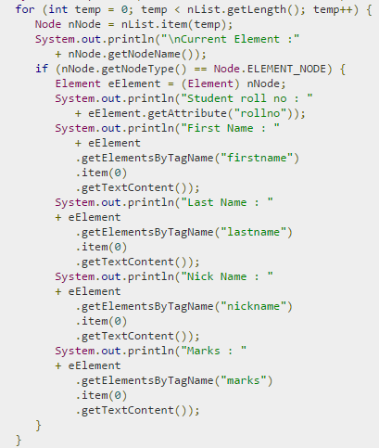
Example Dom Parser
1.
2.
Loop through each Student in list
Prints ‘rollno’(getAttribute)
Prints ‘firstname’ (getElementsByTagName)
3.

Slide 16
OUTPUT
Root element :class
----------------------------
Current Element :student
Student roll no : 393
First Name : dinkar
Last Name : kad
Nick Name : dinkar
Marks : 85
…
Current Element :student
Student roll no : 493
First Name : Vaneet
Last Name : Gupta
Nick Name : vinni
Marks : 95
…
Current Element :student
Student roll no : 593
First Name : jasvir
Last Name : singn
Nick Name : jazz
Marks : 90

